Slide 1

Web Content Filtering with Advanced URL Filtering
MID-STATE TECHNICAL COLLEGE · IT PROGRAMS
Unit 10 · Information Security 2 (10-151-111)
Notes:
Open by connecting to Units 8 and 9: App-ID told us what the application is, Security Profiles inspected what is inside it. This unit asks where the traffic is going. Competency: Configure application control techniques to monitor and control network applications. Lab 9 is this week's hands-on.

Slide 2




Learning Outcomes
By the end of this unit, you will be able to:
Configure web content filtering
Block URL categories in Security policy rules and in URL Filtering Profiles.
Configure usage quotas
Limit when and how much users can reach a category with timeouts, schedules, and QoS.
Apply a DNS filter
Use DNS Security and domain lists to stop bad lookups before a connection opens.
Troubleshoot filtering issues
Read the logs, explain action precedence, and fix miscategorized or unresolved URLs.
Information Security 2 · Unit 10 · Web Content Filtering
2
Notes:
These are the four official objectives for the unit; web content filtering is big enough to get two lessons. Point out that usage quotas and DNS filtering are not in the NETLAB guide, so lessons 3 and 4 are lecture and demo only.

Slide 3
How URL Filtering Works
LESSON 1
Information Security 2 · Unit 10 · Web Content Filtering
Notes:
Lesson 1 is the model: what a URL category is, where the firewall looks it up, and the two places you can use one. Everything in the lab builds on this.

Slide 4

Why Filter Web Traffic?
Malicious and inappropriate websites are the most common way threats reach a user.
Webpages deliver phishing, credential theft, malware, and ransomware.
Attackers spin up thousands of new malicious URLs every day, faster than manual block lists can grow.
Standalone proxies add a second policy set to manage and often can't see encrypted traffic.
Advanced URL Filtering puts web controls into the same Security policy you already use.
SECURITY FOCUS
URL filtering sits at the Delivery and Command-and-Control stages of the attack lifecycle. It stops the user from reaching the site and stops infected hosts from calling home.
Why it matters: One blocked visit to a phishing page can keep a whole network from being compromised.
Information Security 2 · Unit 10 · Web Content Filtering
4
Notes:
Attackers generate thousands of new malicious URLs daily, so static block lists cannot keep up. Stress the integration argument: one policy set on the NGFW instead of a separate proxy product. This is the "why" behind the competency.

Slide 5

PAN-DB and URL Categories
The firewall sorts every website into categories, then you write policy against the categories.
PAN-DB is Palo Alto Networks' cloud URL database. It requires an Advanced URL Filtering license.
The firewall checks its local cache first, then queries the cloud and caches the answer.
A site can carry up to four categories: content (news), plus a risk category.
Custom URL categories are yours to define, and they work without a license.
Where categories work
Security policy
Decryption policy
QoS policy
Authentication policy
URL Filtering Profiles
Categories can match HTTPS without decryption: the hostname is visible in the TLS handshake.
Information Security 2 · Unit 10 · Web Content Filtering
5
Notes:
PAN-DB is the cloud database; the firewall caches lookups locally. Point out that custom categories need no license, which is why the lab still works if a subscription lapses. Categories can be used in Security, Decryption, QoS, and Authentication policy, which matters again in Lesson 3.

Slide 6
Risk and Security Categories
Security-related categories describe a site's risk, not its content:
Category | Meaning | Recommended
high-risk | Suspicious activity, malicious links, or ties to known-bad sites | Block
medium-risk | Some suspicious history, not confirmed malicious | Alert
low-risk | Benign behavior for at least 90 days | Allow
new-registered-domain | Domain registered within the last 32 days | Block
Confirmed bad is separate: malware, phishing, and command-and-control are malicious categories and are already blocked in the default profile.
Information Security 2 · Unit 10 · Web Content Filtering
6
Notes:
Risk categories describe how suspicious a site is, not what it is about. Best practice is to block high-risk and new-registered-domain. A site moves out of new-registered-domain after 32 days. Ask students why attackers like brand-new domains.

Slide 7
Two Ways to Use a URL Category
You can block a category in the rule itself, or in a profile attached to an allow rule.
 | URL category in a rule | URL Filtering Profile
Where | Service/URL Category tab of a deny rule | Objects > Security Profiles > URL Filtering
How it acts | Rule action decides, all or nothing | Separate action per category
Block page | "Application Blocked" | "Web Page Blocked"
Logging | Only the blocked sessions | Any category set to alert or stricter
Information Security 2 · Unit 10 · Web Content Filtering
7
Notes:
This is the central idea of Lab 9: students build both and compare. Policy method is coarse; profile method gives per-category actions and much richer logging. Return to this table during the lab debrief.

Slide 8

Building URL Filtering Profiles
LESSON 2
Information Security 2 · Unit 10 · Web Content Filtering
Notes:
Lesson 2 is the hands-on side of web content filtering: actions, custom categories, EDLs, response pages, and attaching the profile.

Slide 9
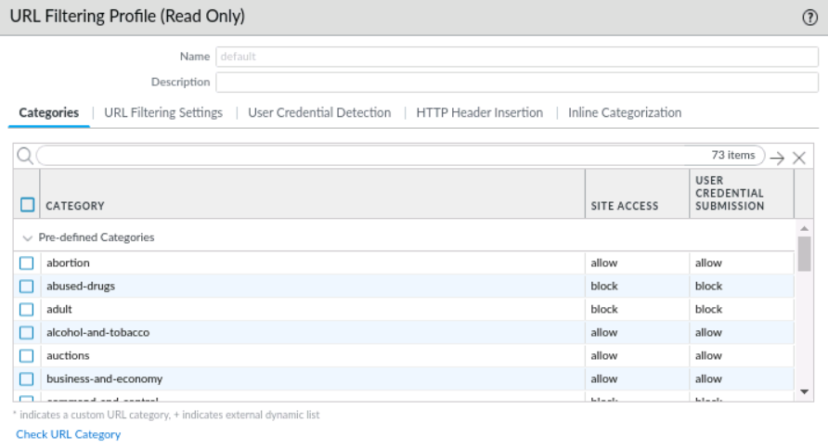
The URL Filtering Profile
Objects > Security Profiles > URL Filtering
The default profile is read-only and blocks malicious and adult categories.
Clone the default, or Add a new profile. A new profile starts at allow for everything.
Use Set All Actions on the Site Access header to change every row at once.
Information Security 2 · Unit 10 · Web Content Filtering
9
Notes:
The default profile is read-only. Clone it or add a new one. A brand-new profile allows every category, so students who forget to set actions get no protection. In Lab 9 they use Set All Actions > alert, then block a list.

Slide 10
Site Access Actions
Each category in the profile gets one action:
Action | What the user sees | Logged?
allow | The site loads | No
alert | The site loads | Yes
block | A block page | Yes
continue | A warning page with a Continue button | Yes, block-continue then continue
override | A page asking for the admin override password | Yes
none appears only on custom categories and lets the site inherit its PAN-DB category instead.
Information Security 2 · Unit 10 · Web Content Filtering
10
Notes:
Allow vs alert is the most common confusion: both let the user through, but only alert writes a log entry. Continue and override log twice, once for the block page and once for the user's choice. Lab 9 sets everything to alert precisely for the logging.

Slide 11
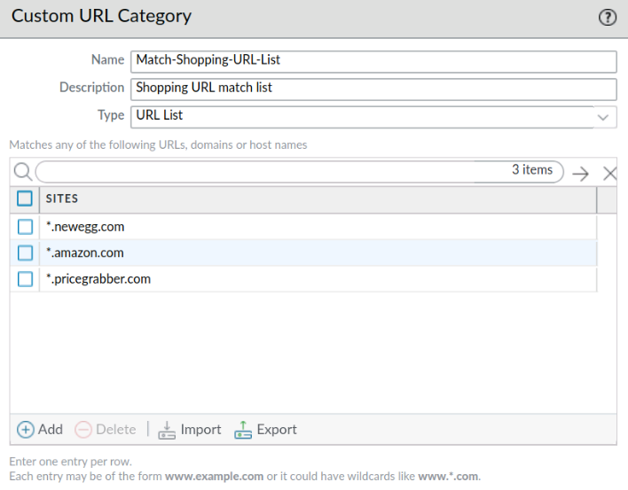
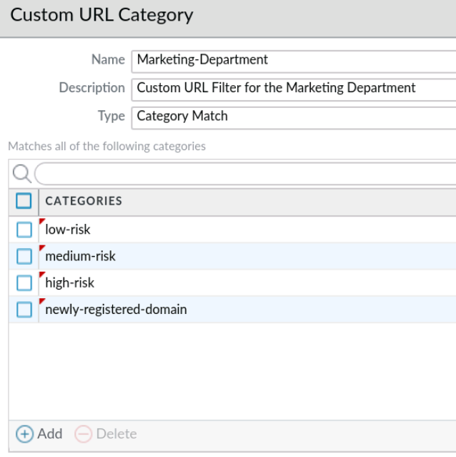
Custom URL Categories
Objects > Custom Objects > URL Category > Add
URL List: specific sites, with wildcards such as *.nbcnews.com.
Category Match: a site must belong to every listed category.
Information Security 2 · Unit 10 · Web Content Filtering
11
Notes:
URL List type is what students build in the lab (Block-Per-Company-Policy). Category Match combines PAN-DB categories with AND logic, for example shopping that is also high-risk. Mention the ending-token prompt they will see, and that wildcards are supported.

Slide 12

External Dynamic Lists
Keep a block list on a web server, and the firewall pulls updates on its own.
An External Dynamic List (EDL) is a text file of entries, one per line, reached over HTTP or HTTPS.
Type URL List appears in profiles and rules just like a category, marked with +.
After the first commit, list changes need no further commit.
Use Test Source URL to confirm the firewall can reach the file.
Lab 9 EDL
Objects > External Dynamic Lists
Name: malicious-urls-edl
Type: URL List
Updates: every five minutes
Information Security 2 · Unit 10 · Web Content Filtering
12
Notes:
The EDL lives on a web server you control. After the first commit the firewall re-reads it on its schedule, so a SOC analyst can add a URL without touching the firewall. In Lab 9 the list holds one entry, www.popurls.com. Mention that EDLs also come in IP and Domain types, which we use in Lesson 4.

Slide 13
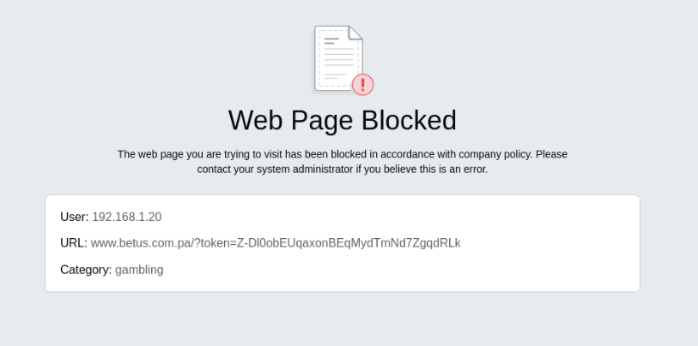
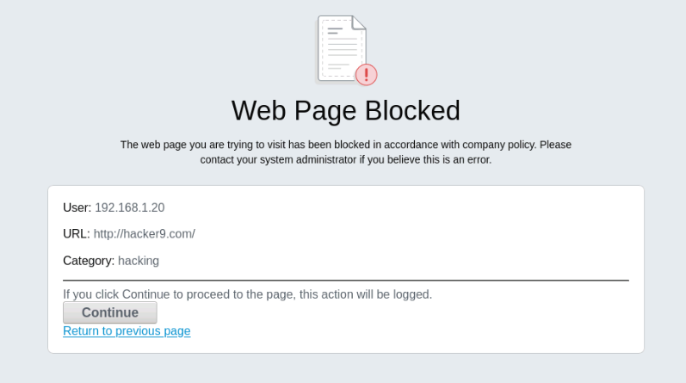
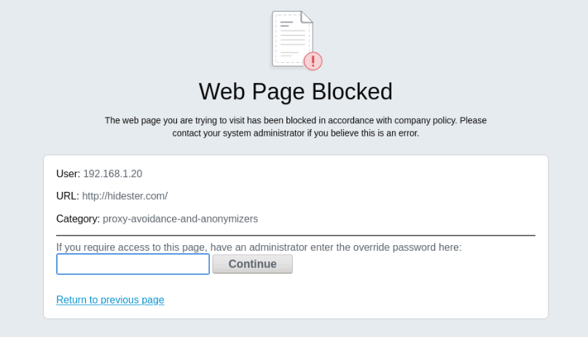
Response Pages
Block, continue, and override each present a different page to the user.
block
continue
override
Customize the pages at Device > Response Pages. Layer 3 interfaces need Response Pages allowed in their Interface Management Profile.
Information Security 2 · Unit 10 · Web Content Filtering
13
Notes:
Each page shows user, URL, and category; with User-ID the IP becomes a username. Continue and override grant 15 minutes to that category by default. Response pages on a Layer 3 interface need an Interface Management Profile with Response Pages enabled, which is a common reason they fail to appear.

Slide 14
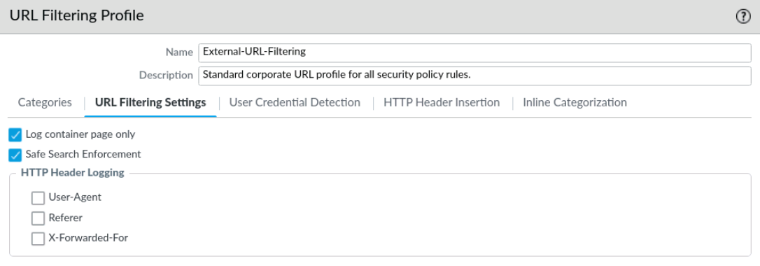
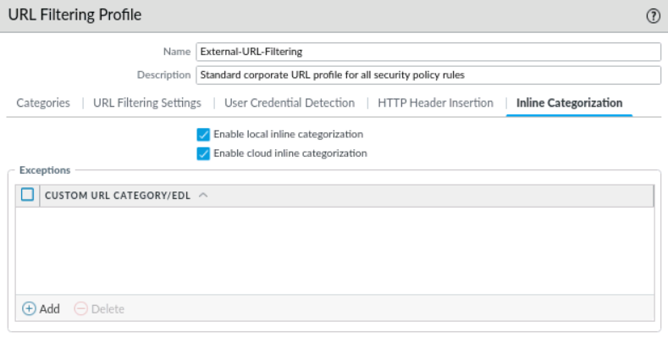
Profile Settings and Inline Categorization
URL Filtering Settings tab
Inline Categorization tab
Safe Search Enforcement blocks results unless the browser uses strict safe search.
Log container page only keeps the log readable. Leave it on.
Local inline categorization runs ML on the firewall.
Cloud inline categorization catches zero-day phishing pages.
Information Security 2 · Unit 10 · Web Content Filtering
14
Notes:
Safe Search Enforcement is best-effort and depends on the search provider; HTTPS search needs decryption. Leave Log container page only on or the log fills with every image and script. Inline categorization uses ML on the firewall (local) and in the cloud to catch phishing pages PAN-DB has not seen yet.

Slide 15
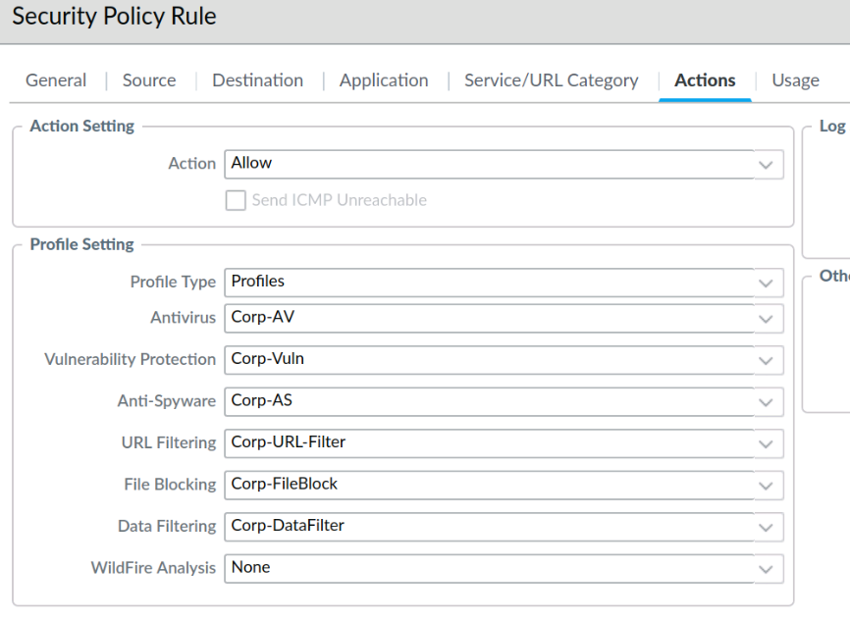
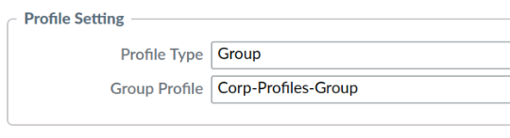
Attach the Profile to an Allow Rule
Policies > Security > rule > Actions
Profile Type Profiles: pick each profile individually.
Profile Type Group: attach a Security Profile Group that bundles them.
Block at minimum: command-and-control, malware, phishing, high-risk, unknown.
Information Security 2 · Unit 10 · Web Content Filtering
15
Notes:
A profile does nothing until it rides on an allow rule. In Lab 9 students add Corp-URL-Profile to the existing Corp-Profiles-Group, so every rule already using the group picks it up. The high-level steps call these by other names; tell students to use the detailed-step names.

Slide 16
Usage Quotas and Time-Based Controls
LESSON 3
Information Security 2 · Unit 10 · Web Content Filtering
Notes:
Lesson 3 covers the usage quota objective. Be upfront: PAN-OS has no per-user minutes-per-day counter like some web proxies. You build the same result from three tools.

Slide 17
Quotas on a Palo Alto Firewall
PAN-OS has no per-user minute counter. It controls usage with three tools instead:
Continue and override timeouts
Let a user in after a warning or password, then make them ask again.
Schedules on Security rules
Allow a category only during set hours, such as a lunch window.
QoS by URL category
Cap the bandwidth a category such as streaming-media can use.
Some web gateways sell true time quotas. Know which tool your platform gives you.
Information Security 2 · Unit 10 · Web Content Filtering
17
Notes:
Products like Forcepoint and FortiGate sell per-user time quotas. PAN-OS approaches the problem with time windows, warning pages with expiry, and bandwidth caps. Framing it this way tells students how to get the result on whatever platform they inherit.

Slide 18
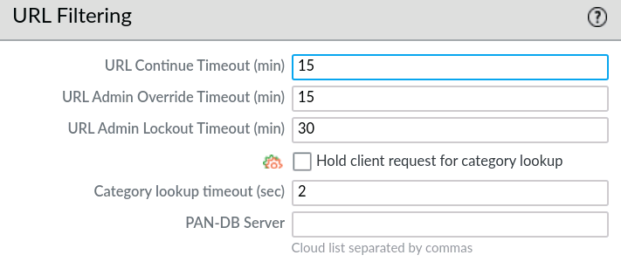
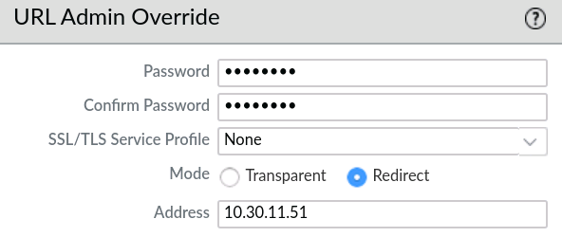
Continue and Override Timeouts
Device > Setup > Content-ID
Timer | Default | Effect
URL Continue Timeout | 15 min | How long a click on Continue lasts for that category
URL Admin Override / Lockout | 15 / 30 min | Override lifetime; wait after three bad passwords
Information Security 2 · Unit 10 · Web Content Filtering
18
Notes:
The continue timeout is the closest thing to a quota on PAN-OS: a user who clicks Continue on a social-networking page gets 15 minutes by default, then sees the warning again. Override uses one admin password per firewall; three wrong tries trigger the lockout timer.

Slide 19
Schedule-Based Access
A schedule object limits when a Security rule is enforced.
Recurrence | Defined by | Example
Daily | Start and end time, 24-hour | 11:30–13:00 every day
Weekly | Day of week plus start and end | Saturday 08:00–17:00
Non-recurring | Start and end date and time | Final exam week only
Objects > Schedules > Add Name: Lunch-Window Daily 11:30-13:00
Policies > Security > Allow-Social-Lunch > Actions > Schedule: Lunch-Window
Schedules apply only to new sessions. Sessions already open keep running past the window.
Information Security 2 · Unit 10 · Web Content Filtering
19
Notes:
Schedules only affect new sessions; a stream that started at 12:59 keeps running. Rule order matters: the scheduled allow sits above the general rule whose profile blocks the category. This pairs well with the continue action on the general rule.

Slide 20

Bandwidth Quotas with QoS
URL categories also work as match criteria in QoS policy.
A QoS profile sets guaranteed and maximum bandwidth for each of 8 classes.
A QoS policy rule matches a URL category and assigns it a class.
Enable QoS on the egress interface at Network > QoS.
Example
Match streaming-media
Assign class 8
Class 8 max egress: 20 Mbps
Business traffic keeps the rest
Policies > QoS: QoS rules have their own rulebase and order. A Security rule alone never limits bandwidth.
Information Security 2 · Unit 10 · Web Content Filtering
20
Notes:
This is a bandwidth quota rather than a time quota. QoS needs three pieces: a QoS profile with class limits, QoS enabled on the egress interface, and a QoS policy rule that matches the URL category. Demo-only; the lab pod does not configure QoS.

Slide 21
Applying a DNS Filter
LESSON 4
Information Security 2 · Unit 10 · Web Content Filtering
Notes:
Lesson 4 builds on DNS sinkholing from Unit 9. URL filtering sees the web request; DNS filtering sees the lookup that comes before any protocol at all.

Slide 22
Why Filter at the DNS Layer?
Every connection starts with a name lookup, so DNS is the earliest place to stop it.
URL filtering sees web requests only. DNS filtering sees lookups for any protocol.
Catches malware command-and-control, algorithm-generated domains (DGA), and DNS tunneling.
A sinkhole answers the lookup with a fake IP, so the infected host shows up in the Traffic log.
SECURITY FOCUS
A blocked web page tells you a user clicked something. A sinkholed lookup tells you a machine is already infected and which one.
Why it matters: You find compromised hosts before the attacker uses them to move laterally.
Information Security 2 · Unit 10 · Web Content Filtering
22
Notes:
Malware rarely browses; it resolves a C2 domain and connects on any port. Blocking at the lookup catches that, plus DGA domains and DNS tunneling. Connect to Unit 9: sinkholing turns the blocked lookup into a log entry that names the infected host.

Slide 23
DNS Security in the Anti-Spyware Profile
Objects > Security Profiles > Anti-Spyware > DNS Policies
DNS Security category (examples) | Typical action | Why
Command and Control Domains | sinkhole | Identify infected hosts
Malware / Phishing Domains | sinkhole | Stop delivery and theft
Newly Registered Domains | block or alert | Young domains are high risk
Dynamic DNS Hosted Domains | block or alert | Favored for throwaway C2
Actions: default, allow, block, sinkhole. Requires a DNS Security or Advanced Threat Prevention subscription.
Information Security 2 · Unit 10 · Web Content Filtering
23
Notes:
DNS Security needs the DNS Security subscription, or Advanced Threat Prevention. Each signature source gets its own action; best practice is sinkhole for malicious categories. The same Anti-Spyware profile from Unit 9 hosts this, so students reuse Corp-AS.

Slide 24
Your Own DNS Block Lists
Block domains you choose, with or without the DNS Security subscription.
Domain List EDL
Exceptions
Create an EDL with type Domain List.
Add it under External Dynamic Lists on the DNS Policies tab.
Set the action to sinkhole or block.
False positive? Add the domain to the DNS Domain/FQDN Allow List.
It lives on the DNS Exceptions tab.
An allow-type EDL does not override a DNS Security verdict.
Remember: DNS policies take effect only when the Anti-Spyware profile is attached to the rule that allows DNS traffic.
Information Security 2 · Unit 10 · Web Content Filtering
24
Notes:
A Domain List EDL is the DNS counterpart of the URL List EDL from the lab. It works without the DNS Security subscription, which makes it the option for shops that only have Threat Prevention. Exceptions go on the DNS Exceptions tab; an EDL set to allow does not override a DNS Security verdict.

Slide 25
URL Filter vs. DNS Filter
 | URL Filtering Profile | DNS Security (Anti-Spyware)
Sees | HTTP and HTTPS requests | DNS queries for any protocol
When | After the connection opens | Before any connection opens
Granularity | Full URL path and category | Domain name only
Best at | Acceptable-use policy, phishing pages | C2, DGA, tunneling, infected-host detection
Logs to | URL Filtering log | Threat log
Use both. Each one catches what the other misses.
Information Security 2 · Unit 10 · Web Content Filtering
25
Notes:
Use this to close the lesson. Defense in depth: the DNS filter stops the lookup, the URL filter stops the page if the lookup slipped through (for example a cached answer or a hard-coded IP). Ask students which one would have caught a malware beacon on port 8443.

Slide 26
Troubleshooting Filtering Issues
LESSON 5
Information Security 2 · Unit 10 · Web Content Filtering
Notes:
Lesson 5 covers the troubleshooting objective. Most tickets are one of three things: the wrong rule matched, a URL is miscategorized, or the firewall cannot reach PAN-DB.

Slide 27
Action Precedence
The firewall evaluates a web request in this order:
 | Check | Result
1 | Security rule action | deny: blocked, no profile check
2 | Profile attached to the allow rule? | No: allowed
3 | URL in a custom category or EDL? | Custom action wins over predefined
4 | Predefined PAN-DB category action | allow, alert, block, continue, or override
Most common surprise: A site in a custom category set to block is blocked even if its PAN-DB category is set to allow.
Information Security 2 · Unit 10 · Web Content Filtering
27
Notes:
Walk the order out loud. Security policy first; a deny ends it. Then no profile means allow. With a profile, custom category actions beat predefined ones. That last point is the answer to most "why is this blocked?" questions.

Slide 28
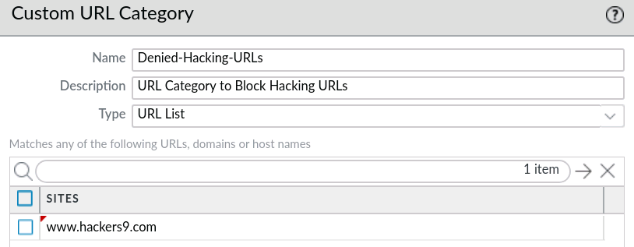
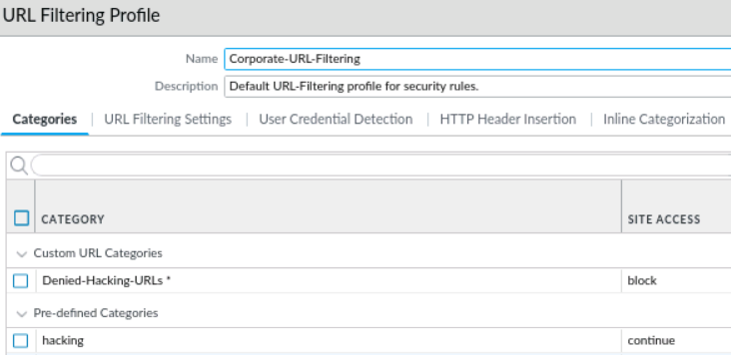
Precedence in Practice
Goal: let Pentesters-Grp reach hacking sites, except www.hackers9.com.
Result: www.hackers9.com matches both categories. The custom block wins, so the site is blocked.
Information Security 2 · Unit 10 · Web Content Filtering
28
Notes:
Pentesters-Grp may visit hacking sites (continue), but www.hackers9.com sits in the custom category Denied-Hacking-URLs set to block. Ask the class what happens before revealing it: block, because custom wins.

Slide 29
unknown vs. not-resolved
Two categories that point at very different problems:
Category | Means | Recommended action
unknown | PAN-DB was asked and has no category yet | block, after reviewing the log
not-resolved | The firewall could not reach PAN-DB | alert, then fix connectivity
admin@firewall> show url-cloud status
admin@firewall> test url www.hacker9.com
Status should read connected. Also check Device > Licenses and management-plane CPU on the Dashboard.
Information Security 2 · Unit 10 · Web Content Filtering
29
Notes:
unknown means PAN-DB answered and has no category yet. not-resolved means the firewall could not ask, usually a connectivity or license problem. Run show url-cloud status first. An expired URL Filtering license also produces not-resolved.

Slide 30
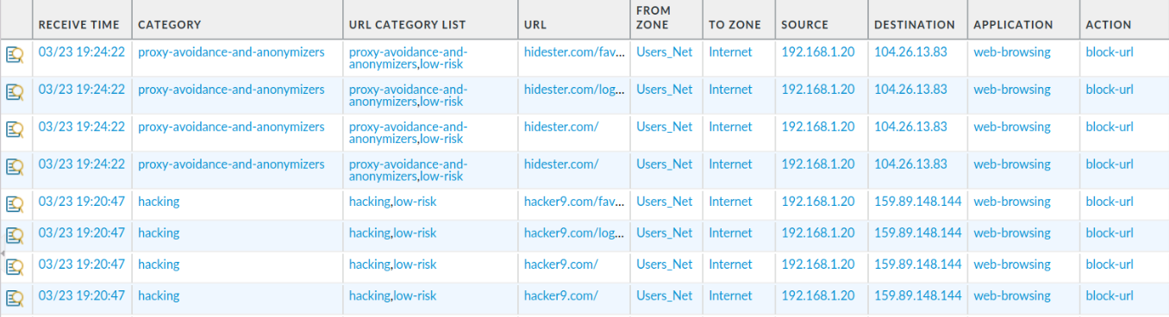
Reading the URL Filtering Log
Monitor > Logs > URL Filtering
( action eq block-url ) ( category eq hacking )
( url contains nbcnews ) ( action eq block-continue )
Category is what triggered the action. URL Category List is every category the site matched.
Information Security 2 · Unit 10 · Web Content Filtering
30
Notes:
Show students how to filter by action and category. The Category column shows the category that triggered the action; URL Category List shows every category the site matched. Profile-based blocks log much more context than rule-based blocks, which students see in the lab.

Slide 31
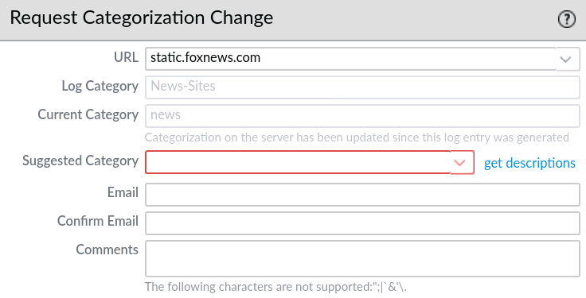
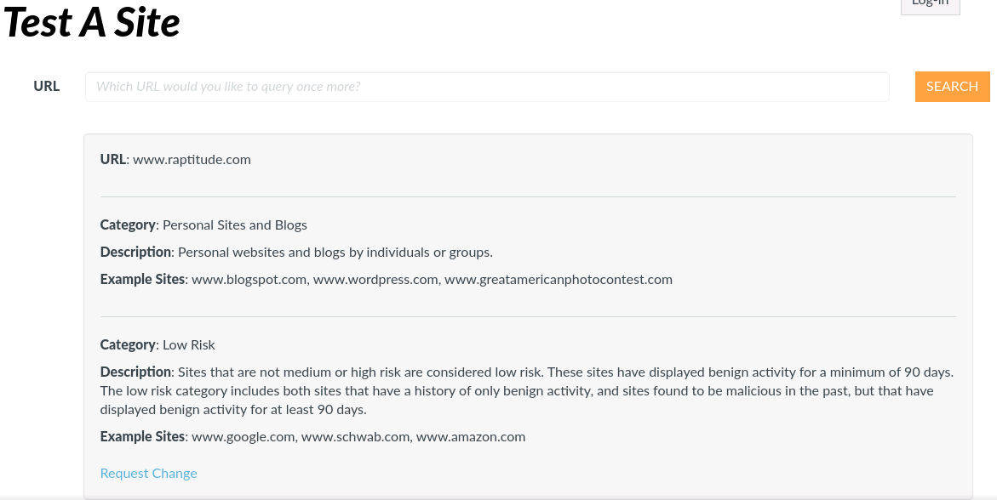
Miscategorized Sites
When PAN-DB gets a site wrong, fix it locally now and request a change upstream.
From the log: open the entry's Details and click Request Categorization Change.
From the web: urlfiltering.paloaltonetworks.com (Test A Site).
Information Security 2 · Unit 10 · Web Content Filtering
31
Notes:
Requests go to a human reviewer, so a comment is required; most are processed within a day. Until then, put the site in a custom category to override it locally. Test A Site is also handy for finding a category before writing policy.

Slide 32
Troubleshooting Checklist
Symptom | Likely cause | Check
Site loads; should be blocked | Profile not on the allow rule | Rule Actions tab or profile group
"Application Blocked" page | A deny rule matched, not a profile | Traffic log: Rule column
No block page, just a timeout | Response pages not allowed | Interface Management Profile
Category shows not-resolved | No PAN-DB connection or license | show url-cloud status
Nothing changed after edits | No commit | Commit, then retest in a private window
Information Security 2 · Unit 10 · Web Content Filtering
32
Notes:
Hand this to students as the lab safety net. Every row comes from mistakes that show up in Lab 9: disabled rules left disabled, profiles never added to the group, and forgotten commits.

Slide 33
Security Thread: Layered Web Controls
SECURITY FOCUS
Layer the controls: DNS Security stops the lookup, the URL Filtering Profile stops the page, custom categories and EDLs let you react in minutes, and schedules and continue pages enforce acceptable use without a hard block.
Why it matters: No single layer sees everything. An attacker who gets past one still has to get past the next.
Pair every allow rule that reaches the Internet with a Security Profile Group that includes URL Filtering and Anti-Spyware.
Information Security 2 · Unit 10 · Web Content Filtering
33
Notes:
Pull the unit together. Each layer covers the gap in the previous one. Ask: if a user's laptop is already infected, which layer finds it? DNS sinkholing. Which layer enforces acceptable use? The URL profile.

Slide 34

Live Demo Inventory
Instructor pod, edu-210-11.0a-09.xml loaded and committed
Add Block-Bad-URLs with URL categories; browse to hacker9.com.
Build Corp-URL-Profile, add it to Corp-Profiles-Group, compare block pages.
Create Block-Per-Company-Policy and test nbcnews.com.
Create malicious-urls-edl and click Test Source URL.
Show a schedule object and the Content-ID continue timeout.
Open the Anti-Spyware DNS Policies tab; run show url-cloud status.
Information Security 2 · Unit 10 · Web Content Filtering
34
Notes:
Run these in order on the instructor pod. Demos 5 and 6 are not in the lab guide, so students see them only here.

Slide 35

Hands-On Lab 9: Advanced URL Filtering
NETLAB+ · PANv11 Firewall Essentials Lab 9 · load edu-210-11.0a-09.xml
Test access to hacker9.com and hidester.com with no filtering in place.
Block categories with the Block-Bad-URLs Security rule, then test and read the logs.
Block the same categories with Corp-URL-Profile and compare the block pages.
Block *.nbcnews.com and *.theguardian.com with a custom URL category.
Block www.popurls.com with the malicious-urls-edl External Dynamic List.
Use Firefox in a private window for every test so cached pages don't hide a block.
Information Security 2 · Unit 10 · Web Content Filtering
35
Notes:
Students choose high-level or detailed steps; recommend detailed. Credentials are in the lab guide's Lab Settings table. Each block test should end with a log screenshot as well as the browser page.

Slide 36
Lab 9 Heads-Up
The lab guide has a few naming slips. Use these names:
Where | Guide says | Use
High-level 1.7 | Corp-Security-Group | Corp-Profiles-Group
High-level 1.7, intro 2.6 | Corp-URL-Filtering | Corp-URL-Profile
Detailed 2.3 step 9 | block-known-bad-urls | Block-Bad-URLs
Detailed 2.5 step 4 | copyright-infrigement | copyright-infringement
Also: In 2.10 the profile, not the rule, does the blocking. At the end, disable Block-Bad-URLs and commit (high-level step 1.21).
Information Security 2 · Unit 10 · Web Content Filtering
36
Notes:
These are errors in the vendor lab guide. Cover them before students start so they don't lose time. The EDL address differs from the Lab Settings table; Test Source URL will tell them which one works.

Slide 37
Key Takeaways
URL categories work in a deny rule or in a profile on an allow rule. The profile gives more control and more logging.
Custom categories and EDLs let you react quickly, and custom actions beat predefined ones.
PAN-OS limits usage with continue timeouts, schedules, and QoS, not a minute counter.
DNS Security stops the lookup before any connection, and a sinkhole names the infected host.
Troubleshoot with precedence, the URL Filtering log, and show url-cloud status.
Information Security 2 · Unit 10 · Web Content Filtering
37
Notes:
One line per lesson. Ask students which takeaway they would use first on a real network.

Slide 38

Unit 10 Homework
Always check Blackboard for assignments and due dates.
Unit 10 Lab: NETLAB+ Lab 9, Blocking Inappropriate Web Traffic with Advanced URL Filtering
Unit 10 Quiz
Lab submission
Capture the browser block page and the matching log entry for each test.
Information Security 2 · Unit 10 · Web Content Filtering
38
Notes:
Last year's deck labeled this slide Unit 9 Homework and Unit 9 Quiz; it is corrected here. Remind students to check Blackboard for due dates.

Slide 39
Questions?
MID-STATE TECHNICAL COLLEGE · IT PROGRAMS
Unit 10 · Web Content Filtering with Advanced URL Filtering
Notes:
Take questions, then point students to Lab 9 and the Lab 9 Heads-Up slide before they start.

